Slide 1
Python and its Applications
Speaker: Alex Nellis, PhD Student and Senior Reactor Operator
Feb 12, 2025

Slide 2
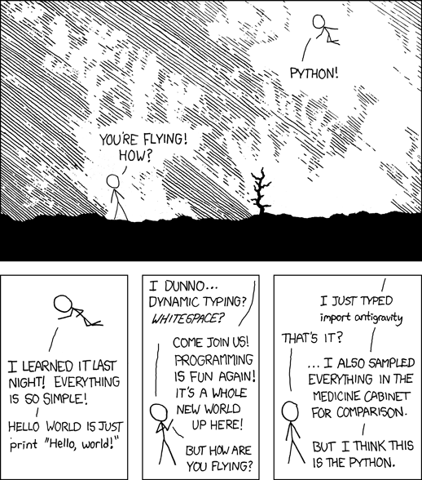
Why Python?

Slide 3
Basic Syntax
Most Common Types:
Integer (int) : used for whole numbers
Floating Point (float) : used for fractional numbers
Complex Numbers (complex) : used for imaginary and complex mathematics
String (str) : used for characters or words
Boolean (bool) : represents True/False states
Lists (list) : used for editable collections of other variables
Tuple (tuple) : used for constant collections of other variables
Dictionary (dict) : used for keyword – value pair collections
NoneType (None) : used to represent no value or uninitialized variable

Slide 4


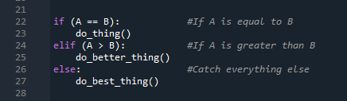

Logic Statements, Branching, and Loops

Slide 5

Modules
90% of the time, someone already wrote code you can use
Imports can be aliased using the “as” keyword
Specific functions can be imported with “from”

Slide 6



Fun with Lists
Lists are most commonly used for handling data in Python
List comprehension is the fastest, native method of generating lists in Python
Access elements with indexing
Add elements using “append” or “insert”
Remove elements with “pop” or “remove”

Slide 7
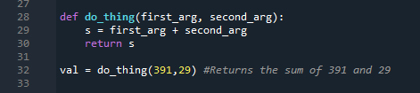

Functions
Traditional declaration
Lambda declaration

Slide 8
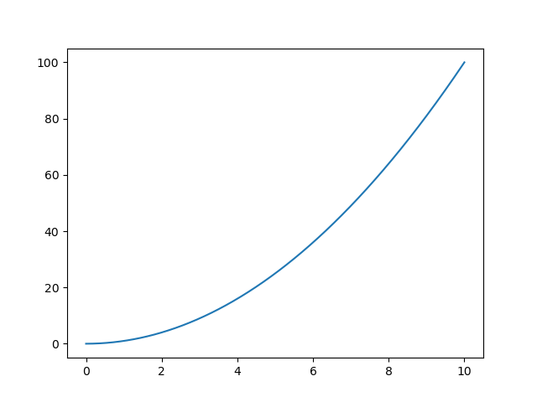
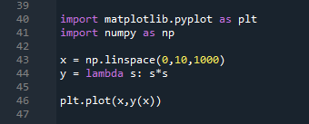
Data Visualization with Matplotlib

Slide 9
(Most) Documentation is your Friend!

Slide 10
OpenMC : the people’s Monte Carlo

Slide 11

Material Definitions
OpenMC Materials require 2-3 things
Atomic content
Density
Thermal Scattering Data (if necessary)

Slide 12
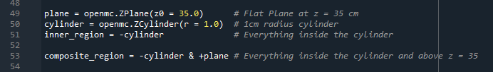
Geometry Definitions
OpenMC geometry is generated with Constructive Solid Geometry (CSG)
Built from basic shapes and surfaces
Regions defined from inside/outside a given surface
Cells are built from a material filler and a defining region
Universes are built from a collection of cells
Lattices are built from a collection of universes

Slide 13
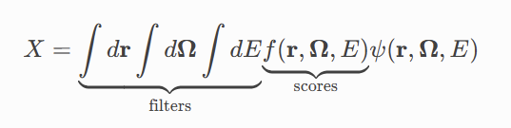

Tallies for When It Needs to Count
Tallies collect data when the simulation is running
From the OpenMC website
Filters govern where the tally is collected (in space, energy, angle, etc.)
Scores govern what is collected (fission rate, flux, decay rate)

Slide 14
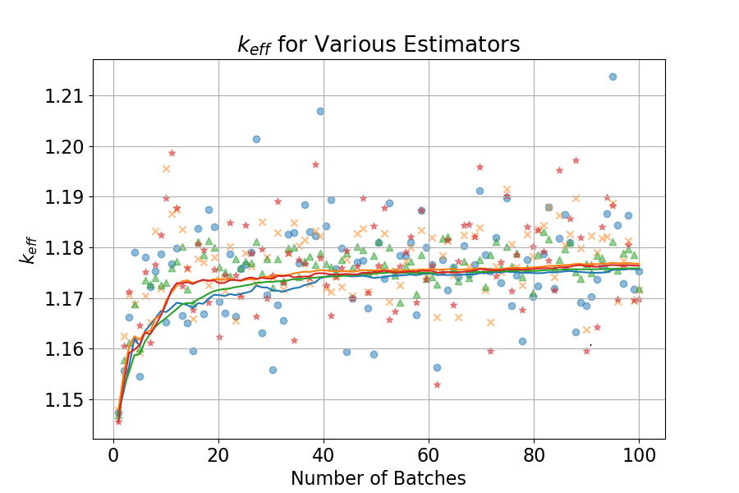
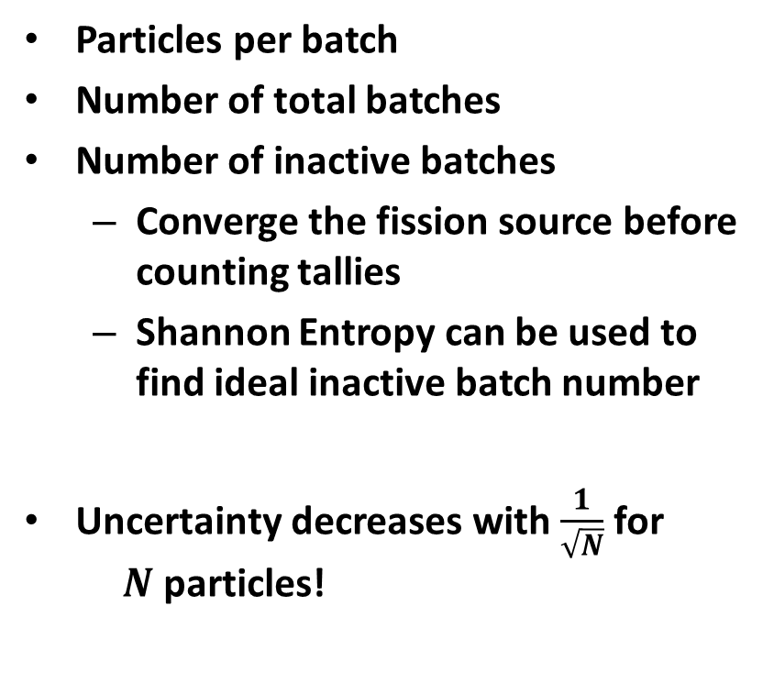
Simulation Settings
Particles per batch
Number of total batches
Number of inactive batches
Converge the fission source before counting tallies
Shannon Entropy can be used to find ideal inactive batch number
Uncertainty decreases with $\frac{1}{\sqrt{N}}$ for $N$ particles!

Slide 15
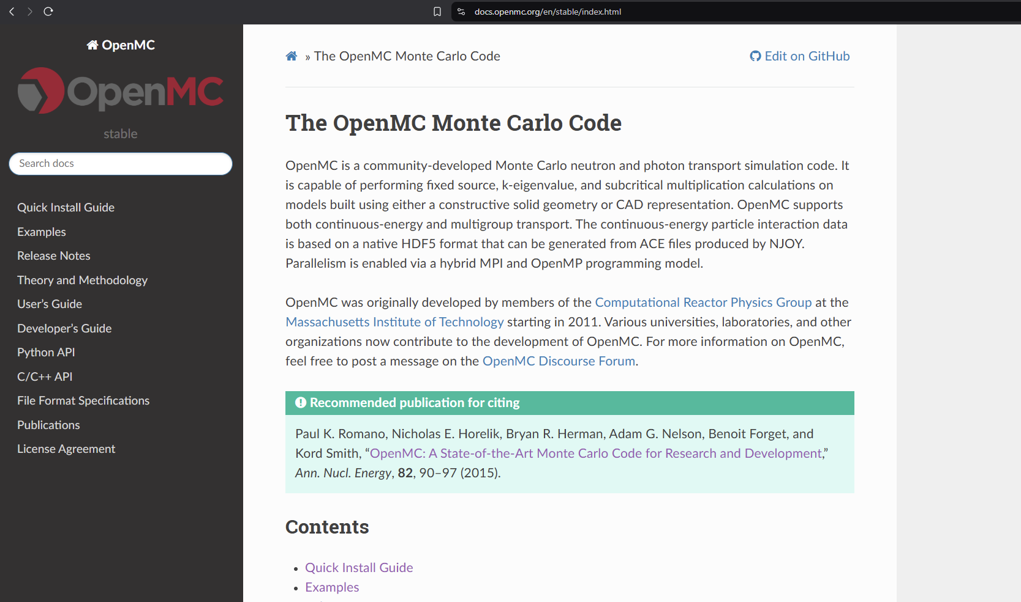
OpenMC Documentation and Examples

